Slide 1
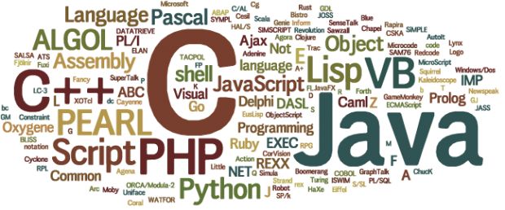
Preferred Programming Languages
By Chenchen Feng, Jess Gardin, Jarrid Jones
Kalpana September 2022

Slide 2
Executive Summary
We conducted a Natural Language Process (NLP) project on analyzing the contents of README.md of GitHub repositories to predict the primary programming language of choice after web scraping 848 repositories related to “inflation”.
The top preferred programming languages are Python, JavaScript,and R.
The baseline (mode) performed with an accuracy of 42.12% on train sample data.
We developed a Random Forest (TF-IDF) model with max depth of 7 that performed with accuracy of 51.43% on test sample data.

Slide 3
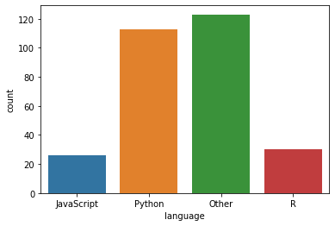
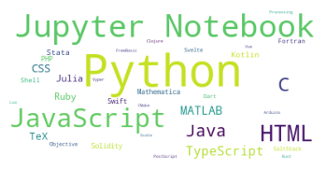
Acquisition and Preparation of data
The data comes from the best matching repositories related to “inflation’ on GitHub as of 2 SEPT 2022. Git Hub query
Raw data: 848 Repositories
Refined data: 523 Repositories
There were initially 40 programing languages. We chose the top three and combined the remaining into “Other” category.
As a team, we chose to tokenize and lemmatize the text prior to splitting the data into three samples, exploration and modeling

Slide 4
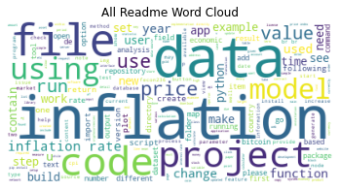
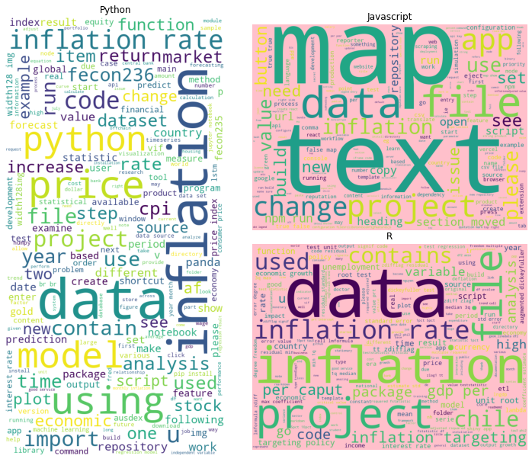
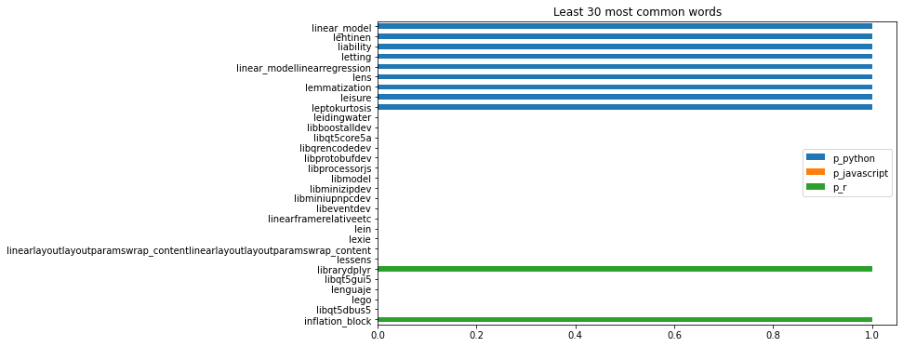
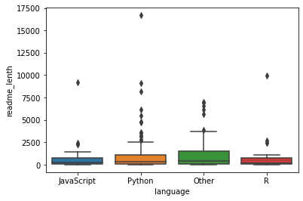
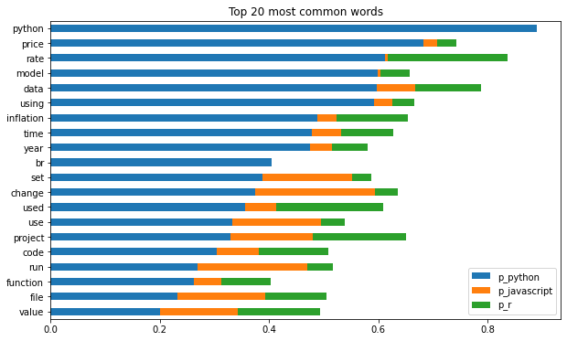
Exploration
What are the most common words in all READMEs related to the inflation topic?
Does the Readme will vary in length based on program language?
What are the most common words in python, javascript and R besides the key word inflation?
Are there any words that uniquely identify a programming language?

Slide 5
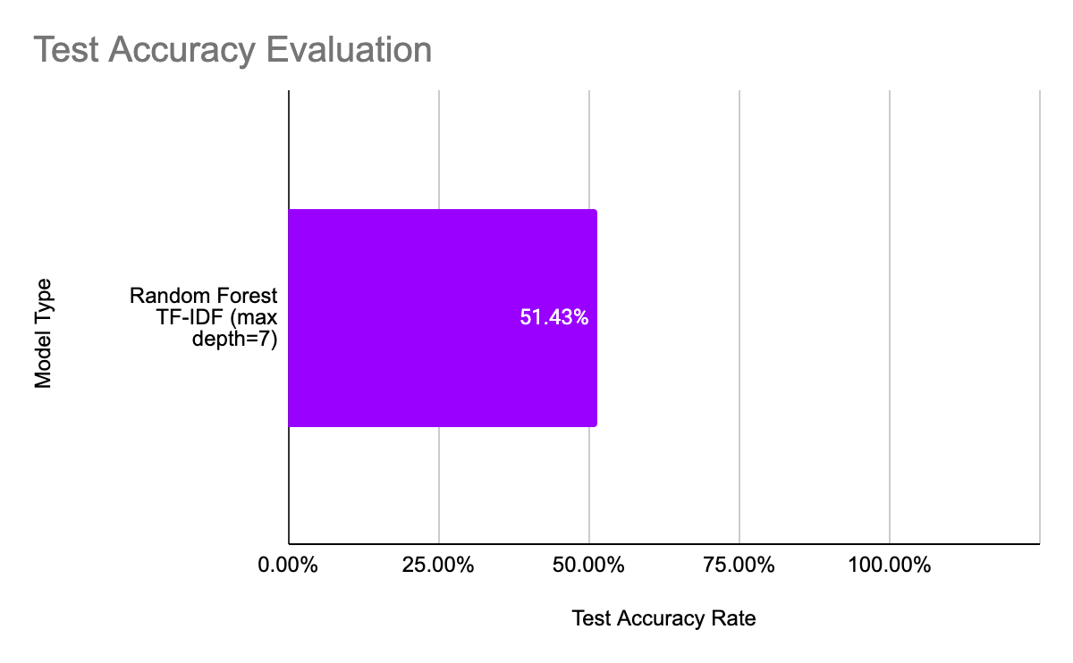
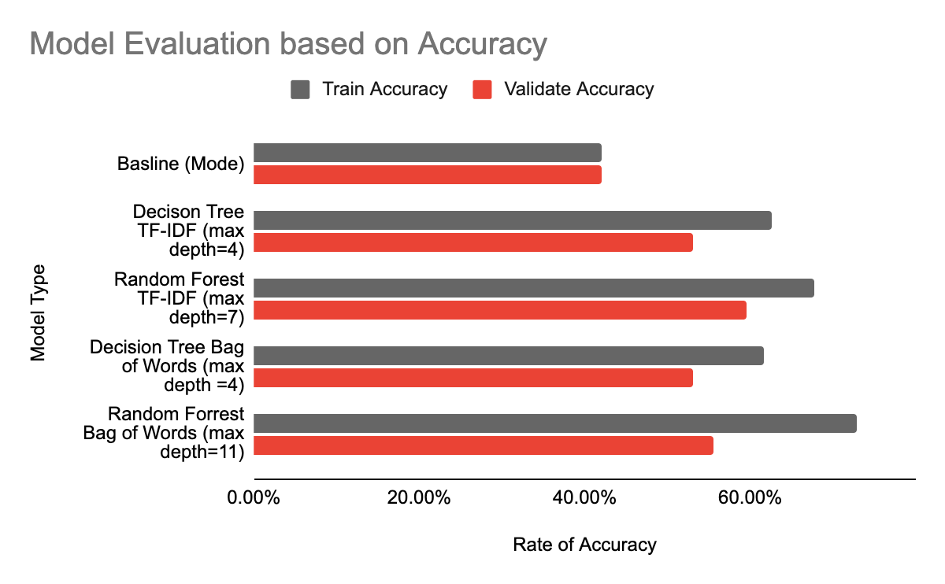
Modeling
We developed five Classification models.
Baseline line model with the Program Language mode.
Decision Tree and Random Forest models with Term Frequency- Inverse Document Frequency (TF-IDF)
Decision Tree and Random Forest models with Bags of Words
The Random Forest (TF-IDF) model with max depth of 7 that performed with accuracy of 51.43% on the Test sample
Evaluating the best performing model on Test sample

Slide 6
Conclusion
We conducted a Natural Language Process (NLP) on analyzing the contents of README.md of GitHub repositories to predict the primary programming language of choice.
The preferred programming languages are Python, JavaScript, R.
We developed a Random Forest (TF-IDF) model with max depth of 7 that performed with accuracy of 51.43%
Next Steps:
Adjust stop words to remove the words like 'data' and 'inflation' to try and get more specific and unique wording for each language.
Evaluate the data with different classification models such as KNN
Try unsupervised learning to see if there are any new insights into the different groupings of data.

